Slide 1
The impact of innovation on processing receivables
June 2020
U.S. Bank Global Treasury Management

Slide 2
Today’s presenters
Mike Hunter
Receivables Group Product Manager
U.S. Bank
Bryan Schneider
Working Capital Consultant
U.S. Bank

Slide 3
Catalysts of change: past, present and future
The pace of change in the last three years has been faster than ever

Slide 4
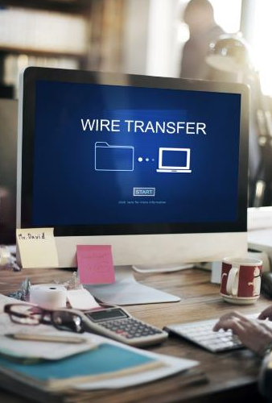
Legacy payment rails
Cash/check | Wire | ACH | Card

Slide 5
Technological advancements in payments
Consumers drive payment tech Mobile Square Voice enabled payments
Global innovation influence Real-Time Payments (RTP®) Request for Payment

Slide 6
What’s the impact on receivables processing?
Close the circle between payments and reconciliation
Decreasing paper
Increasing exceptions
Relationship to payer data
Invoice to pay automation
Real-time posting
The relationship between payee and payer drives speed of payment to posting

Slide 7
The age of user experience driven innovation
Focus on both ends of payment journey: payee and payer
Meet users where they are
Streamline posting
Billers offering positive payment experiences build loyalty
Consumers
Trading partners

Slide 8
Collaboration as the cornerstone
Solutions should solve problems for all parties, including the payer and payee
Expedited design partnerships deliver solutions in weeks
Iterate toward perfection: release quickly, receive feedback and make adjustments

Slide 9
Things to consider about receivables processing
Be empowered to partner in innovation
Assess opportunities to improve processes
See end disclosures.

Slide 10
Join us for next month’s webinar
International payments: Trends and solutions for today’s global market
Thursday, July 16, 2020
11 a.m. PT, noon MT
1 p.m. CT, 2 p.m. ET
IQ
Learn more at Financial IQ:
https://financialiq.usbank.com/index.html
Follow us on LinkedIn:
https://www.linkedin.com/showcase/corporate-and-commercial-banking/about/
See end disclosures.

Slide 11
Disclosures
Deposit products offered by U.S. Bank National Association. Products and services may be subject to credit approval. Eligibility requirements, restrictions and fees may apply. You will need Internet access on your mobile device and may be charged access fees by your carrier, dependent upon your mobile plan. Check with your carrier for details on specific fees and charges. Member FDIC. ©2020 U.S. Bank
RTP® is a registered service mark of The Clearing House Payments Company L.L.C.

